Slide 1
Administrative Referee
October 13, 2018

Slide 2
The Keys to Success
Meet Announcement
Preparation
Organization – A “Game Plan”
Prioritization & Efficiency
Consistency
Be Calm, Professional and Smile!

Slide 3
Meet Announcement
The rules that govern the meet are found in the meet announcement
Section 4 of the Rules and Regulations outlines rules for preliminary and finals Age Group Meets
Section 5 of the Rules and Regulations outlines the rules for preliminary and finals Senior Meets
Ask the meet referee if you can review the meet announcement prior to sanctioning. Be his/her second pair of eyes
Read and Highlight all important information
Notes:
Nan leads this part

Slide 4
Pre Meet Preparation
Discuss protocols with meet referee
Make a “Game Plan”
Conference call with Admin Team
Communicate
Prepare Binders
Gather Supplies
Review the Rules
Notes:
Protocols:
Late or Forgot Check in, No Shows,
DQ Log (Admin vs CJ) time changes,
split heats, radio protocol,
coach issues – when to involve MR
Conference call: Meet protocols, preparation and assignments, the “plan”
Know your Resources and where to find them.
Daily Binder;:dividers by event,
Admin book – meet announcement, emails, computer change form, HS un-attach, DQ Log, Count sheets, Radio protocol, radio sign out sheets etc.
Scratch books : boys and girls binders, separated by event, scratch sheets, event listing, and finals scratch log
Supplies: pencil, red pencil, pens, clip boards,
Communicate: Meet Director, Pacific Staff (FW), Head Starter (rotations), Team Lead Judge
Other options: Wording for Announcer plus a log, Estimated timelines,

Slide 5
Admin Team

Slide 6
Office
“Corner Packet”
Colorado
Deck Ref*
Starter
OOF
CJ
Admin*
Evaluator
Assist Lead Admin as necessary
Double check seeding
Review preliminary & final results
Help with no-shows
Work with runners
Build daily binder
Swim offs as necessary
Work with Meet Director or Pacific staff
“Daily Binder”
Scratch Sheet from check-in
Seeded Prelims
Prelim Results
Scratch Paperwork
Seeded Finals
Results
“Daily Binder” becomes
the “Final Binder”
Notes:
Coach Check – in:
Have coach sign –in, give bag-tag or wrist band (Option of the host). Collect phone numbers, sign concussion paperwork.

Slide 7
Check-in
Train and supervise check-in Volunteers
Mark check-in sheets with exceptions/issues
Close and Seed preliminary events
Process no-shows
Monitor timeline
Distance check-in
High School Athletes
Notes:
Mark check-in paperwork with exceptions prior to opening. (The night before is best)
Resolve exceptions and issues daily.
Exceptions: too many events per day or total # of events exceeds cap. Time verification. Finals penalty (AG)
HS Athletes: CIF Rules. Does not affect Nevada athletes.
Reminder: Un-attached athletes can not swim in a relay 102.3
Watch the timeline and H/L posting area. If athletes are gathered around you are in trouble.
Seeding
No show rules differ for Age Group and Senior athletes –
Age Group prelims: – barred from their next preliminary individual event
Finals: barred from the rest of finals and if no finals that day – barred from 1st preliminary event
Senior Prelims- – barred from the rest of his/her events for the day including relays.
Finals: - barred from the remainder of the meet.
No-show on final day= If the no show occurs on the last day that the athlete is entered in an individual finals event and no other individual event penalty is applicable – the athlete shall be fined $100.
Mistakes Happen – Not the end of the world. If Admin mistake make sure to insert athlete in the heat he/she belongs. Does everyone know how to split a heat?

Slide 8
Review Preliminary Seeding
Calculate the number of preliminary heats after scratches
For Example:
If you have 80 entries – 9 scratches there will be 8 heats (6 full heats, 1@8 and 1@3) in an 10 lane pool
If you have 144 entries and 13 scratches, how many preliminary heats should there be in a 10 lane pool:
14 Total Heats – 12 Full, 1@8 and 1@3
Heats | 8
Full | 6
Partial | 1@8
Partial @3 | 1@3
# Entered | 80
# Scratched | 9
# Seeded | 71

Slide 9
Intermediary
Work with timing operator
Review heat results
Resolve timing issues quickly,
Track all DQs, DFS, NS and changes
Close each event with Deck Referee
Prepare packets for office
DQ Log and radio protocol as necessary
The Packet
Colorado
Admin
Deck Referee
OOF
CT Heat Results
Lane Timers
Notes:
What is the advantage of having an Admin next to the timing operator?
What is the primary timing system?
Ask for help if you have a timing issue. – especially if it occurs during the 50s

Slide 10
Scratch Book
Process scratches
Work with announcer and runners
Notify coaches if their athlete has scratched into a final
Close events after the 30 minute period
Keep track of intents
Proof finals heat sheet prior to printing
Prepare binder for Finals
Notes:
Tape a list of events on the table. Athletes don’t always know there event number.
Scratch = Does not want to swim in finals
Intent = thinking about swimming in Finals.
An intent must return to declare his/her intention 30 minutes after the announcement of finalists in his/her last event. Otherwise the athlete will swim in finals.
Make sure that the announced preliminary results must be brought to the scratch table.
Scratches can occur as soon as the scratch book opens. You do not need results.
As soon as you have a scratch start notifying coaches.
Sunday there will be a lot of scratches
Use the Finals scratch log – it will help you keep track of everything.

Slide 11
Lead Admin
Everything mentioned earlier plus
Follow Meet Protocols established with Meet Referee
Work with Meet Director and/or Pacific Staff (FW)
Work with computer operator
Time Verification/Proof of time
Coach Assignment
Review results
Prioritize work flow
Make a plan but be flexible
Notes:
Time Verification – will be done by Staff prior to the start of the meet. Emails will be sent to coaches of the athlete with issue.
Athlete must bring proof to the meet.. The “proof” must be from sanctioned meet or an observed HS Championship meet. International times are cleared through Laurie.
Coach Assignment – work with MD – for athletes at the meet w/o a coach.
Reminder: Circle seeding for the fastest 3 heats then seeded by time.

Slide 12
Be Calm, Professional and SMILE!

Slide 13
National Deck
Scratch Cards & Scratch Box
The next days events are seeded the night before
More Binders with more information
Technical meeting
Closing events for seeding includes math!
Positive check in folders (distance and Relays)
Timelines
Tv deadlines
The Administrative Referee tasks are a little different on the National Deck.
Sectionals
Zone Championships
Pro Series,
Juniors and Nationals
Notes:
The scratch box is used in some LSCs at Age Group Meets.
National Deck trend is to eliminate additional paperwork. Hence DFS are recorded on the DR/AR paperwork instead of filling out a DQ slip.
Positive check-in for distance and relays is going away – instead only scratches are taken. (some Lead ARs)

Slide 14
Keeping Paperwork Organized
A Finals Scratch Log can be used to help keep the Scratch book process organized.
An Announcer’s Log should be used to track events that have been announced and returned to the Admin
FINALS SCRATCH LOG
Event # |  | Time Announced |  | 30 MIN Close | Time Closed | Last Intent | # of Scratches | Given to Computer Person | Blessed | Finals Posted
 | Event
25 | Woman's 200 Butterfly
26 | Men's 200 Butterfly
27 | Woman's 100 Freestyle
28 | Men's 100 Freestyle
29 | Woman's 100 Breaststroke
30 | Men's 100 Breaststroke
31 | Woman's 500 Freestyle
32 | Men's 500 Freestyle
Announcer
Event | Name | Time Announced | Returned to Admin
25 | Woman's 200 Butterfly
26 | Men's 200 Butterfly
27 | Woman's 100 Freestyle
29 | Woman's 100 Breaststroke
30 | Men's 100 Breaststroke
31 | Woman's 500 Freestyle
32 | Men's 500 Freestyle

Slide 15
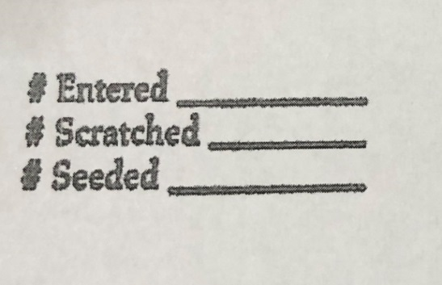
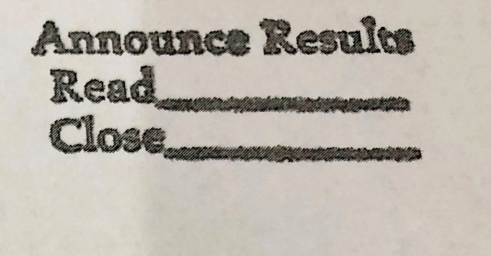
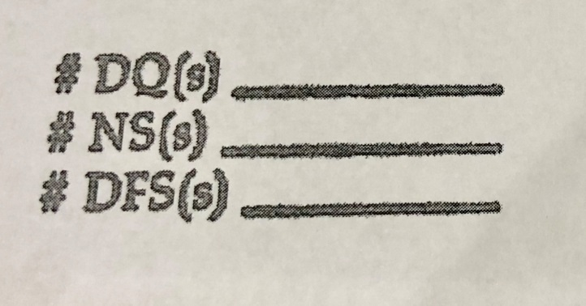
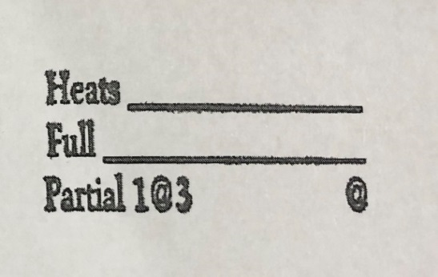
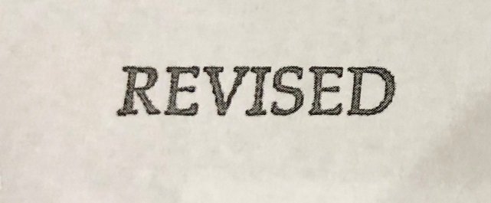
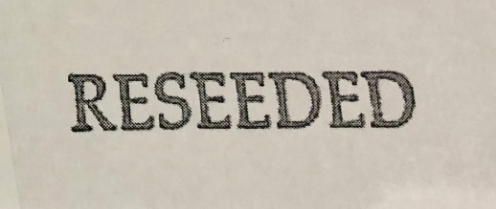
Stamp Samples
Additional stamps include:
Prelims Post, Positions (DR, OOF, Colorado), Results…

Slide 16
Resources
Seeding Rules: USAS Rulebook 2017.11.7
Proof of Time: USAS Rule Book 207.7
Forms: *Can be found on USAS and/or Pacific websites
DQ Log*
Finals Event Scratch *
No Show from Final Event *
High School Season – “un-attach”
Finals Scratch and Announcer’s Log
Relay Early Take Off (master copy)*
Computer Change*
Count Sheets (Distance events)*
Coach Sign in*
Membership and Transfer*

Slide 17
Questions?

