Slide 1

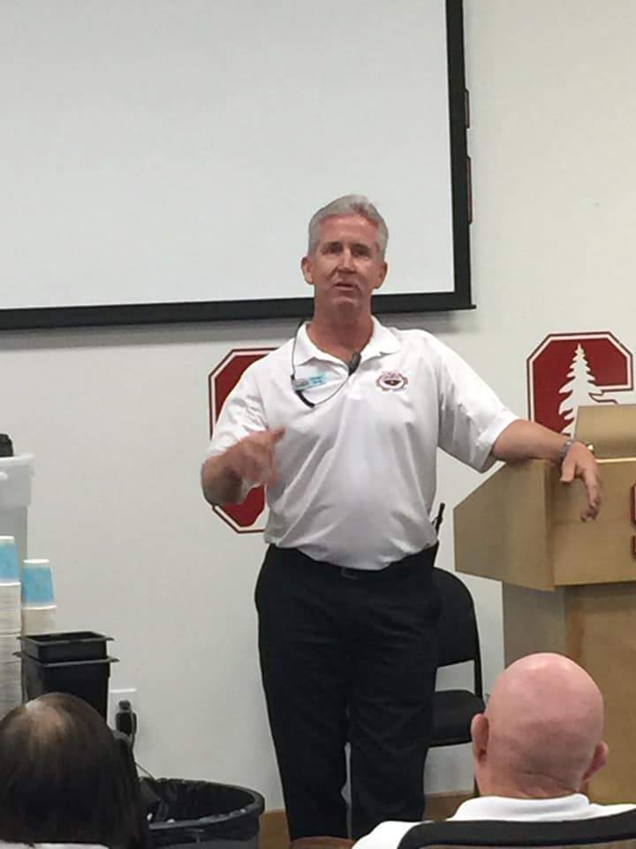
Deck Referee Clinic
Deck Referee Clinic
October 4, 2025

Slide 2
Clinic Goals
GOALS FOR TODAY’S CLINIC:
You will learn about the Deck Referee Routine and Protocols
You will learn about the essential communication between the DR and SR
We will cover the following topics
The Team
Pre-Meet
During Meet
Interacting with Coaches
Other things that come up

Slide 3
o Does the Deck Referee job well and doesn’t overstep those responsibilities unless asked by the Meet Referee o Self-evaluates after all shifts, sessions, and meets he Professional
The Professional Deck Referee:
Can adapt to Meet conditions and needs
Is willing to learn
Doesn’t read more into the rules than is written, and generously applies common sense, ALWAYS giving Athletes the benefit of the doubt
Appreciates Athletes, Coaches, Officials, and Volunteers of all levels and interacts with them respectfully on all occasions
Is neatly uniformed, looks confident, is competent
Advises the Meet Referee of any non-routine decisions made. If possible, involves them in making those decisions
Does the Deck Referee job well and doesn’t overstep those responsibilities unless asked by the Meet Referee
Self-evaluates after all shifts, sessions, and meets

Slide 4
Pre-Meet
Know the rules and the official interpretations published by the USA Swimming Rules Committee
Read and understand the information in the Meet Announcement, including warm-up requirements
Be flexible and adaptable to all procedures made by the Meet Referee, Head Starter, or Head Deck Referee that may differ from the suggested guidelines offered in this document
Confirm assignments, rotations, and invigilating schedule with the Meet Referee or Head Deck Referee or Head Starter
If assigned to invigilate controlled warm-up:
Coordinate with the assigned Starter to observe the pool and enforce compliance with warm-up rules
Open pace lanes and racing start lanes at the designated time in accordance with posted warm up procedures (open additional racing start/sprint lanes if demand warrants). Coordinate with the Announcer and Marshals
Review deck set-up in general such as flags, 15M tape, traffic patterns, etc.– quietly alert Meet Referee to any irregularities or safety issues

Slide 5
The Team
The Deck Referee is responsible for a fair environment in which the swimmers will be competing.
To accomplish that, the deck is staffed with numerous people with different jobs.
The Deck Referee must be a facilitator in helping that staff get their jobs done correctly and at the same time allow them the freedom to do those jobs.
While the Deck Referee needs to know all the jobs of the others on deck, it is not his or her job to do them all.
The Deck Referee lets other Officials perform their assigned role.

Slide 6
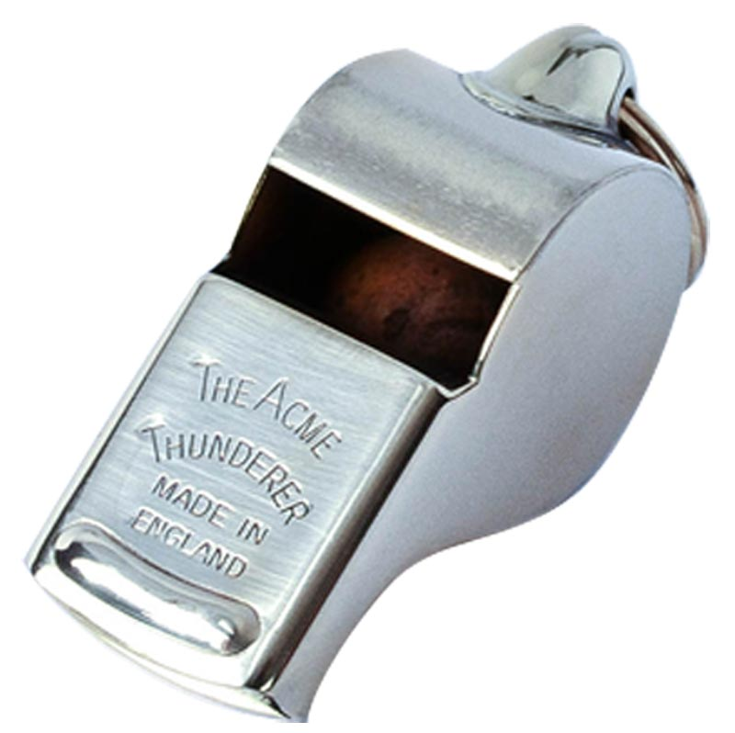
Deck Referee Tools
Whistle – Please try not to use a Fox40 Whistle as it has a shrill pitch. The Acme Thunder is the whistle of choice ! Have a back-up in your pocket as well!
Clipboard- Something waterproof is good as we are outdoors. There is nothing that notes that you cannot hold a clipboard while “On-Duty” as a Deck Referee at any Meet, including National Meets. At a CBA Meet, you may have a lot of disqualifications to go through, so having a clipboard in your hand will be helpful. From the National Official’s Chair: At National Level Meets, maybe try to just have your event page when you are on deck, folded, and in your back pocket.
Pen(s) – Have a pen that does not bleed! Maybe have a back-up as well!
Hat & Sun Glasses

Slide 7
The Team
Stroke & Turn Judges
They are your observers - the most important position on deck. The official who can most affect the swimmer.
Chief Judges
The managers - they are your eyes, your ears and your communication link to the deck & other officials.
Starters
Key individual for a smooth, flowing session
Strive to make every start their best start.
“Teammate” in setting consistent, fair playing field.

Slide 8
The Team
Announcer
Valuable resource for facilitating communications with Coaches and Athletes (e.g. re-swims and swim-offs)
Need to work closely with for finals procedures
Meet Referee
Responsible for entire meet operations
Establishes guidelines regarding protocols/procedures for a given meet that the Deck Referees, Starters and Judges need to follow
Allows the “Team” to conduct the meet
The next level to which Coaches can go on an issue

Slide 9
Procedures
What are the scratch procedures for the meet? Meet specific or National Scratch rules?
What are the procedures for “no-shows” and declared false starts?
Will a swimmer who misses their race be allowed to swim in a later heat? Processed by AR/AO, but outcome determined by the Meet Referee.
Check with MR – will this be a paperless meet? Other recording protocols?

Slide 10
DR/SR Team – Communication is the Key
DR/SR Partnership – “Best Teams Work as One for the Athletes”
Start early to talk with your DR(s); DQ process, additional commands for swimmers, backstroke protocol;
Where will you stand for starting events; DR position?; The “hand-off” – SR should be able to see the DR hand without actually having to look at it
Any anticipated situations, any “unique starts”, protocols (backstroke ledges, disabled swimmer, delayed start protocol, fall-ins, etc.)
Will the DR be giving you directions (clear the pool, step swimmers down, etc.)
Full heat; Empty Lane #; No comments; Fly-overs, Etc.

Slide 11
Pre-Meet-Communication with your Starter
No matter the size or level of the meet, the Deck Referee and Starter must be a team that communicates. The teamwork begins when you are assigned to one of these two roles, whether it is for the entire session or a few events within a session. Even before starting your pre-session checks, you both should have a conversation regarding potential circumstances that might come up, such as how false starts are to be handled, should the SR communicate empty lanes/full heat, etc. During this time, or in the minutes before the event, the SR is the first to pick their spot for the best view of all lanes. The goal for the DR in choosing their position is the same: an unobstructed visual gaze over the lanes. However, the DR must also keep in mind that their outstretched arm, signifying the heat has been given to the SR, must be easily and peripherally visible. This is another example of the teamwork necessary to ensure the SR, as well as the DR, maintains sight of all athletes at the blocks before the start.

Slide 12
Deck Referee / Starter Interactions
The SR may report to the DR when the anticipated number of athletes are all present, or only when there is an empty lane, depending on what is established in the pre-session dialogue. For the forward start, the short whistles are blown and are followed within seconds by the long whistle to initiate the athletes’ transition onto the blocks. Once the athletes are steady, meaning there is no evidence of imbalance on the blocks, the DR hands over the heat to the SR. It is now up to the SR to decide when to give the start command and the start signal. If all is well, the two watch the swimmers enter the water before going into their distinctly different roles. The SR, who is aware of the amount of time the DR is spending processing calls, can be very helpful by providing information on which swimmer is trailing behind and anything of importance regarding athletes in the next heat. The DR can help the SR by their own demeanor and walking away to take calls. This allows the SR to calmly observe the behavior of the swimmers in the next heat. Prior to the start, any issue that has the potential to create inequity may require the DR to retract their arm. The outstretched arm does not relieve the DR from full control of the heat.

Slide 13
Deck Referee / Starter Interactions
If need be, the DR may ask the SR to “Stand”, “Relax”, or have the athletes “Step down carefully.” The field has been returned to the DR, at this point. The team may spend a moment in conference, take action (i.e. false starts, fall-ins) if needed, and bring the heat back onto the blocks with the DR blowing the long whistle. Should a false start or fall-in occur, both the SR and DR mark their sheet independent of one another. The SR initiates the call by approaching the DR, observing first whether radio communication is taking place. The SR uses a phrase that will get the DR’s attention, like, “I have a potential…” The two show their sheet with the markings on the lane of the swimmer who committed the false start, thus solidifying the independence of their calls. If there is a confirmed “False Start” and radios are being used, the Deck Referee will call over the radio “False Start”, lane #. Please note that less is more. No need to say “confirmed” false start as you are called in a false start due to it already being confirmed. Also, no need to add “please write it up and notify the Athlete” as the Chief Judge will be doing their job to follow protocol. ﻿ The goal of effective communication between the SR and DR is to develop a team approach to ensure the best possible outcome for the athletes we serve.

Slide 14
Establishing a Deck Referee Routine
Position on Deck in the Starter Area
Ask Starter to establish their position before every session in your pre-session conversation.
Communication: Prior to the start of the session, verify that the Timing system operator is ready, as well as your Starter – everyone ready?
Whistle Protocol
Preliminaries – short whistles are blown per the Meet Referee’s instructions. The long whistle is blown after the last Athlete finishes their race. The pacing is determined by the Meet Referee’s instructions.
Finals - Short whistles are blown after all swimmers have paraded onto deck, removed all extraneous gear, and been announced. Long Whistle is blown approximately 5 seconds after short whistles
Style of Whistles
4 or 5 sharp, crisp short whistles; any more are unnecessary noise.
1st long whistle same volume as shorts
Backstroke – 2nd long whistle should be the same volume as shorts

Slide 15
Establishing a Deck Referee Routine
USA Swimming - Hand Off Protocol
Protocol
Forward Start – after all the swimmers have stepped onto the blocks and all are steady in their position
Backstroke Starts –
With Backstroke Ledges: Start End Judges move forward to the edge of the pool at the first long whistle (can observe if there are any issues with the ledges) At the second long whistle the SE Judge shall observe the placement of toes, one toe from each foot must be in contact with the touch pad (or wall if no touch pads). After the toes are in the correct starting position, the SE Judge shall look forward / down the length of the pool. When all SE Judges look up, the Deck Referee shall then turn the heat over to the Starter.

Slide 16
Establishing a Deck Referee Routine
Several things to Consider Prior to Hand Off on Backstroke Starts with Ledges:
Are you able to recognize if the straps are twisted
Is there a process/staff to ensure integrity of the ledge
Can you radio for the Start Area CJ to assist? or
Are there facility staff assigned to assist in this process?
Are the Start End Judges still looking down?
Are the Start End Judges instructing the Athlete regarding placement of feet?
Is there another concern that would delay the hand off?

Slide 17
Establishing a Deck Referee Routine
After the Start
Observe head-ups on all swimmers
Check Scoreboard
Check Start End Judges, then Stroke Judges (15M mark)
Check Heat Sheet; mark False Starts
Radio in No Shows, Declared False Starts, False Starts
While the Swimmers are Racing
Scan the venue for safety issues (wires, cords, ledges in the water)
Return gaze to check Judges
Timers

Slide 18
Establishing a Deck Referee Routine
As the Swimmers are Finishing
Complete processing of paperwork – DQs
Be cognizant of your last swimmer
Count heads again
After the Last swimmer has Touched
Depends on Fly-over vs Clearing pool
May need to instruct Starter to clear the pool
Used judiciously
Always “Thank you, Ladies/Gentlemen”, or if mixed events, then “ Thank you, Swimmers”

Slide 19
DQ Procedures
DQ slips
Radio protocol
Accept/reject; ask for clarification if unable to decide in a timely manner.
Potential disqualification clarification: Garbled radio transmission, or language used in the call. A personal conversation may be needed for clarification. The CJ may suggest “needs further discussion” based upon the Judge’s call.
Record DQs, FSs, DFSs, & NSs on your heat sheet. Have a system that works for you that allows you to track the meet.
Notification to swimmer- by Chief Judges or Stroke and Turn Judge.

Slide 20
Swim-Offs
Swim-Offs: At Championship Meets where there is a Prelims session and a Finals session, the Deck Referees may be asked to arrange the Swim-Offs.
After a Deck Referee’s rotation, they should make their way over to the Admin. Table to verify if there are any potential Swim-Offs. Any ties are denoted on the results sheet with an asterisk (*). You are looking for any ties that would possibly move an Athlete in another group of finalists, or if an alternate might move into a championship heat, or a few place past the finalists in case of scratches. If there are any potential Swim-Offs, ask for a copy of the results to go and speak to the Coaches of the Athletes in the potential Swim-Off. Ask when they would like to swim the swim-off. (Remember, the swim-off must take place within 45 minutes of the Athlete’s last preliminary race). Never schedule a swim-off just prior to Finals. In rare cases, say if one Athlete has left the facility, a swim-off may be conducted prior to warm-ups for Finals commencing.
If the Coaches and Athletes agree to have a swim-off, take the information and let the Admin. Team know so that they can prepare the paperwork, i.e. Timer sheets, Deck Referee, Starter, Timing System Operator, etc. Also, let your Chief Judge Team know so that Officials will be available.

Slide 21
DQ Procedures
Handling a Protest
If a Coach should come to you with a protest and you are
“On-Duty”, try and get the “next-up” Deck Referee to fill for you
if one is available. If not, let the Coach know that you will be done in about “x” minutes and you will come and find them. Never “blow-off” a Coach, EVER! After listening to the Coach’s concern, find the TLCJ, or another Chief Judge to go and investigate. When they come back with the information and can “paint the picture” of what happened to your satisfaction and you choose to uphold the call, go to the Coach and inform them of your decision. If, after the Chief Judge comes back to you and you are still not comfortable, go to the Judge who made the call to investigate further. After making your decision, report to the Coach. Remember, the Coach can always take their protest to the Meet Referee.
Remember, if there is a protest, let the Admin. Team know to hold the results. Also, let them know the final outcome so that they can release the results.

Slide 22
Splitting a Heat
Splitting a Heat – This may be done by the Admin. Team prior to the event being swam. If not, you as the Deck Referee need to be able to do this quickly and efficiently! Always have the Starter communicate to the Athletes as to what is happening.
Almost always, splitting a heat is usually to put an Athlete into the event in the spot that they would have been seeded in. The reason for this could be that they were scratched incorrectly, or other reasons that the Meet Referee or Admin. Referee may know off.
The standard protocol for splitting a heat is to have the entire heat come to the blocks. Have the Starter announce that you are going to split the heat. Have the Starter tell the outside lanes (1 and 8 for this example) to step back. Let them know that they will be swimming in the next heat (if heat 2 is being split, the next heat will be heat 2A). Tell the Starter to inform the Athletes that heat 3 will swim after heat 2A. Send the heat with lanes 2 through 7.
For heat 2A, the Athlete that is being added will be in lane 4 (if 8 lanes are being used). Lane 1 will go to lane 3, Lane 8 will go to lane 5. Have the CJ go to the Lane Timers to write down the added heat.
Remember, clear communication is key! We want the Athletes to not be stressed!

Slide 23
Other Thoughts
Primarily focus on the race – the Chief Judges (if used) are watching the officials
Consider your “body language”
Don’t “hang out” with the Starter; avoid long conversations
Keep focus on the pool; NEVER turn your back to the pool
By observing the race, you might see the same infraction as a Judge
Try to anticipate what the call might be
Keep the “Admin. table” informed of DQ’s, no show’s, lane/heat changes, etc.
Use your Chief Judges when possible as they are your concierge (not to ever excuse an Athlete. That is your job should it be necessary).
Note: Never, Ever watch a video during the Meet!
Remember, it’s your pool! You also set the Meet pace, precedent, and feel for the session. A calm demeanor is infectious.

Slide 24
WHAT IS A FALSE START?
The rules state… “When all swimmers are stationary, the starter shall give the starting signal” (101.1.2C), and,
“Any swimmer initiating a start before the signal may be disqualified if the Referee independently observes and confirms the Starter’s observation that a violation occurred. Swimmers remaining on the starting blocks shall be relieved from their starting positions with a "stand" command and may step off the blocks.”(101.1.3A).
So, what constitutes a false start? These scenarios should help you paint the picture.

Slide 25
FALSE START SCENARIO #1
Swimmer leaves the set or stationary position prior to the starting signal. The starting signal is then given. The race proceeds and, assuming the Starter observed the early start and the Deck Referee independently observes and confirms the Starter’s observation, the offending swimmer is disqualified at the conclusion of the race.
Rule 101.1.3B applies. This is a false start.

Slide 26
FALSE START SCENARIO #2
Swimmer leaves the set or stationary position prior to the starting signal. The swimmer upon realizing the early starting motion attempts to catch himself/herself. Starter says absolutely nothing, and the swimmer fails to halt the forward motion and goes into the pool.
Rule 101.1.3A applies. This is a false start.

Slide 27
FALSE START SCENARIO #3
Exactly the same facts as #2 above, but this time the Starter says “Stand, please” after the swimmer leaves the set or stationary position. The seven other swimmers stand or step down from the blocks. The offending swimmer struggles, but once again is unable to halt the forward motion and falls into the pool.
Unlike scenario #2 , here the starter said “Stand, please”, but that does not change the false start result. The rule is clear that the "stand" command is for the benefit of the other swimmers on the starting blocks. When the stand command is issued, the athletes have the option of standing or stepping off the blocks. The offending swimmer did neither. He fell into the pool just like the swimmer in scenario #2.
Rule 101.1.3A applies. This is a false start.

Slide 28
FALSE START SCENARIO #4
Exactly the same facts as scenarios #2 and #3 above. However, this time when the command “Stand, please” is issued, the offending swimmer struggles, but is able to stand or step off the blocks.
Rule 101.1.3A applies. This is NOT a false start. Why? Because the swimmer remained on the blocks or deck like everyone else in the heat, and no starting signal ever sounded.

Slide 29
FALSE START SCENARIO #5
Exactly the same facts as scenarios #2 and #3 above. However, when the Starter gives the “Stand, please” command a swimmer(s) other than the offending swimmer instantly bolts from the blocks and enters the water.
Rule 101.1.3D applies, “A swimmer who would otherwise be charged with a false start may be relieved of the charge if the false start was caused by the swimmer’s reaction to a “stand” command.”
The swimmer(s) clearly started in reaction to the “stand” command. This is NOT a false start.

Slide 30
FALSE START SCENARIO #6
The swimmer, upon hearing the command “Take your marks” starts down to take a set or stationary position. The swimmer loses his/her balance before coming set and falls into the pool.
Rule 101.1.2C applies. The swimmer should be given the opportunity to come to his/her set or stationary position prior to the start. A loss of balance prevented that, and clearly this swimmer never engaged in any starting action. This is NOT a false start.

Slide 31
FALSE START SCENARIO #7
During the race start, the referee whistles the swimmers up onto the blocks, then hands over the heat to the Starter. Upon the "Take your marks” command, the swimmers come down and become stationary, but before the starter starts the race, one swimmer moves forward, but does not leave the block. Rather than asking the swimmers to "Stand Please," the Starter chooses to wait and the swimmer becomes stationary again along with the rest of the heat. The starter then starts the race which runs to completion and no disqualification was made.
Rule 101.1.2C applies. The swimmer should be given the opportunity to come to his/her set or stationary position prior to the start. The swimmer regained their set position prior to the starting signal. This demonstrates the patience that is required for a Starter to have for each heat of swimmers. This is NOT a false start. A great example of a PURPOSEFUL PAUSE!!!

Slide 32
Resolution and Resetting After a Fall-In
1. The DR and SR should always independently indicate on their Heat Sheet if they believe any fall-in swimmer(s) committed a false start. This can be done using a circle or mark on the applicable lane. The rationale for this is based upon our current practice where written observation is shared prior to any conversation.
2. If the SR has a possible false start due to a fall-in, they should initiate and approach and show their written observation to the DR. If, “…the Referee independently observes and confirms the Starter’s observation…” then the Athlete(s) is disqualified for a false start. After disqualifying the Athlete(s), the DR blows another long whistle to initiate the starting sequence again.

Slide 33
Resolution and Resetting After a Fall-In
3. Once the DR and SR have compared their written observations, conversation may be held to determine if there were any issues surrounding the fall-in that might relieve the athlete(s) from the disqualification. Consideration is given to were they set, did another athlete react to the offending athlete, did the athlete(s) react to a sound, etc. If it’s mutually determined that there is a violation, then a disqualification is warranted. The heat is told, “Step down, please”; the DR informs the violating athlete(s) of their DQ, and the athlete(s) is not permitted to swim this event. The DR blows another long whistle to initiate the starting sequence again.
4. If the DR and SR do not confirm that an athlete(s) false started, (i.e. not being set, different offending athlete, was there a sound, etc.) then no violation has occurred, and the swimmer(s) is relieved of the potential false start, and the DR blows another long whistle to initiate the starting sequence again.

Slide 34
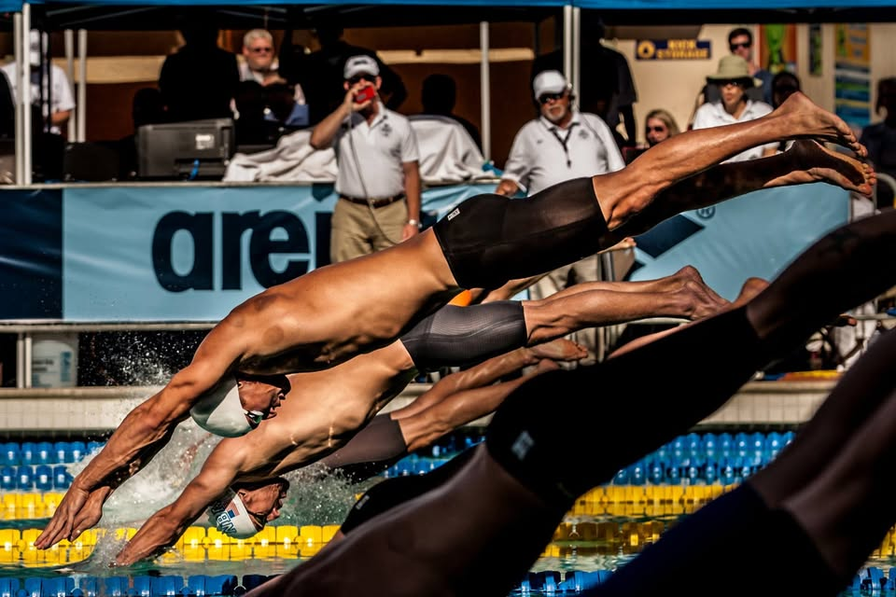
Open Discussion / Q & A / Situations and Resolutions

