Slide 1

ADMIN CLINIC
Part 2 – Timing Rules
[102.23]
OCTOBER 4, 2025

Slide 2
TIMING SYSTEMS
102.23.2
Automatic (touchpads)
Semi-Automatic (buttons/plungers)
Manual (stopwatches)
Notes:
Automatic (touchpads)
A timing system activated by a starting device and stopped at the finish by the swimmer touching the touchpad.
Semi-Automatic (buttons/plungers)
A timing system activated by a starting device and stopped by buttons pushed by timers at the finish touch of the swimmer.
Manual (stopwatches)
A timing system consisting of individual lane timers, each operating a manual watch that is both started and stopped by the timer.

Slide 3
TIMING SYSTEM DESIGNATION
102.23.3
Primary | Secondary | Tertiary
Automatic | 1, 2, or 3 buttons | At least 1 watch
Automatic | 1, 2, or 3 watches | n/a
2 or 3 buttons | At least 1 watch | n/a
3 watches | n/a | n/a
Notes:
Primary determines official time.
Back-up (secondary or tertiary) is used to corroborate or correct any missing or inaccurate results.
Unless the primary system is manual watches or secondary is fully integrated video system or includes at least one (1) manual watch per lane, a tertiary system of at least one (1) manual watch per lane is needed.
Notice there is a manual watch requirement for each designation – this is in case the timing system malfunctions (i.e. late start etc)

Slide 4
KNOWLEDGE CHECK

Slide 5
Which of the following system designations are acceptable and complete?
PRIMARY | SECONDARY | TERTIARY | ACCEPTABLE?
Touchpads | 3 Buttons | None | NO
B. Touchpads | 1 watch | None | Yes
C. 1 Button | 2 watches | None | NO
D. 3 Buttons | 1 watch | None | Yes
E. Touchpads | 1 Button | 2 watches | Yes
Notes:
A – Unless the primary system consists of manual watches or the secondary system is a fully integrated video system or includes at least one (1) manual watch per lane, a tertiary system of at least one (1) manual watch per lane shall be provided. 102.23.3C
B – if using buttons as primary, minimum is TWO 102.23.3A(2)
A primary system shall always be in place and shall consist of one of the following, listed in their preferred order of use:
(1) Automatic Timing.
(2) Semi-Automatic, with three (3) or two (2) buttons per lane, each operated by a separate timer.
(3) Manual, with three (3) watches per lane, each operated by a separate timer.

Slide 6
DETERMINING OFFICIAL TIME
102.23.4

Slide 7
DETERMINING OFFICIAL TIME
102.23.4C
0.30 sec
If times are approximately more than 0.30 apart, there is a possible malfunction.
Notes:
102.23.4C
Primary Timing System Malfunction — A malfunction may have occurred if:
(1) The difference between the time obtained by the primary system and the back-up system(s) is approximately .30 second or greater; or
(2) The place judge(s) reports a different order of finish (OOF); or
(3) It is reported the swimmer missed the touchpad or had a soft touch.
This is not a hard stop, use judgment, rules say “approximately”, sometimes a difference of .31 or .32 or .33 is fine, collect more data if needed.

Slide 8
All 3 buttons within 0.3 seconds
  official time is the intermediate time [102.23.4B(2)]
 | Lane 1
Button | 2:23.24
Button | 2:23.12
Button | 2:23.19
FINISH | 2:23.19
Notes:
102.23.4B(2)
If three VALID buttons or watches disagree, the time of the intermediate button or watch shall be the time for that timing system.

Slide 9
Slowest and fastest buttons within 0.3 of intermediate (middle) button
  official time is intermediate time [102.23.4B(2)]
 | Lane 1
Button | 2:23.68
Button | 2:23.12
Button | 2:23.40
FINISH | 2:23.40
Notes:
102.23.4B(2)
If three VALID buttons or watches disagree, the time of the intermediate button or watch shall be the time for that timing system.

Slide 10
Only two buttons AND within 0.3 sec
  Official time is the average of the two buttons [102.23.4.B(3)]
 | Lane 1
Button | 5:10.00
Button | (no timer)
Button | 5:09.94
FINISH | 5:09.97
Notes:
102.23.4B(3)
If only two valid button or watch times are available, the time shall be the average of those two buttons or the average of the two watch times. The digits representing thousandths of a second shall be dropped with no rounding.

Slide 11
One outlier out of three buttons
  Discard outlier and average the two remaining valid buttons
  Check that order of finish (OOF) does not change
 | Lane 3 | Lane 6 | Lane 7 | Lane 8
Button | 28.43 | 26.65 | 30.58 | 25.92
Button | 27.85 | 26.55 | 30.61 | 25.36
Button | 27.94 | 26.60 | 30.48 | 25.64
FINISH | 27.94 | 26.60 | 30.58 | 25.64
Notes:
Only two buttons are “valid” (within .3). We only use “valid” times. Therefore, the invalid time – the outlier – must be discarded. We then average the remaining two button times.

Slide 12
One outlier out of three buttons
  Discard outlier and average the two remaining valid buttons
  Check that order of finish (OOF) does not change
Averaging
Method A:
 | Lane 3
Button | 28.43
Button | 27.85
Button | 27.94
FINISH
27.85 + 27.94 = 55.79
55.79 ÷ 2 = 27.895
OFFICIAL TIME: 27.89
Notes:
28.43 is outlier (i.e. not valid - discard)
Calculate average of 2 remaining valid buttons
Average of 27.85 and 27.94 = 27.89
Drop the thousandths

Slide 13
One outlier out of three buttons
  Discard outlier and average the two remaining valid buttons
  Check that order of finish (OOF) does not change
Averaging - Method B:
.94 - .85 = .09 .09 ÷ 2 = .045 27.85 + .04 = 27.89
 | Lane 3
Button | 28.43
Button | 27.85
Button | 27.94
FINISH
OFFICIAL TIME: 27.89
Notes:
Averaging – method B

Slide 14
All buttons more than 0.3 seconds apart
  Talk to lane timers/ref/starter/colorado
  Any notes on lane timer sheet? (e.g., early/late buttons?)
  Get coach time and corroborate with OOF and stopwatch
  Use best judgment to determine official time
  Use the button that best agrees (within 0.3 sec) with coach time & OOF
 | Lane 1
Button | 1:02.13
Button | 1:01.56
Button | 1:02.95
FINISH
NOT VALID!

Slide 15
One button only
  Corroborate with OOF, Coach time, entry time
  Check stopwatch (if operated by different lane timer)
  Check with lane timer, starter, deck ref
*NEVER average times from two different timing systems (e.g. button and stopwatch)

Slide 16
…other scenarios…
Buttons malfunctioned in ONE lane
  Use stopwatch time and corroborate with OOF
Lost entire heat and cannot be reprinted from Colorado stored data
  Use stopwatch times and corroborate with OOF
If no buttons/stopwatch (or buttons and stopwatch are bad)
  Get coach time and corroborate with OOF
If no buttons, but stopwatch and coach times disagree
  Use stopwatch, unless coach time agrees with OOF

Slide 17
If no available timing data (no buttons, no SW, no coach time)
  Talk to Ref, Starter, Lane Timers
  Was swimmer ahead/behind? Body lengths?
  Did timers forget to stand up?
  Refer matter to Lead Admin (or Meet Referee)

Slide 18
EXERCISE

Slide 19
EXERCISE: Determine the official time
 | Lane 1 | Lane 2 | Lane 3 | Lane 4 | Lane 5 | Lane 6 | Lane 7 | Lane 8
Button | 2:28.31 | 2:30.49 | 2:47.59 |  |  | 3:17.29 | 2:05.13 | 2:56.24
Button | 2:28.80 |  | 2:48.09 | 3:11.07 |  | 3:16.98 | 2:05.45 | 2:56.46
Button | 2:28.80 | 2:30.74 | 2:47.54 | 3:17.08 | 2:04.77 | 3:17.61 |  | 2:56.05
FINISH
Notes:
Strikethrough = possible malfunction
Ln 1 = 2 of 3 agree
Ln 2 = 2 valid times (within .3) = average
Ln 3 = throw out outlier, average remaining 2 buttons
Ln 4 = 6 seconds apart, do not average (you only average valid button times, and obviously one isn’t valid)
Ln 5 = look at watch + OOF (if watch time and OOF agree, then use 2:04.77 - otherwise, get coach time)
Ln 6 = edge case; remember .3 is just a guide, possible malfunction, not a speed limit or hard stop, need judgment
Ln 7 = it’s up to your judgement to decide whether 0.32s difference is a “malfunction” or invalid button time
(e.g., if Btn B has been consistently slow, consider ditching that button and using 2:05.13. Decide whether it’s worth the time/effort to investigate further. Remember that the manual watch time will most likely be the same ln timer as either Btn A or B - it will most likely agree with one of them.
Ln 8 = fastest and slowest within .3 of middle, official time is middle button

Slide 20
SOLUTION: Determine the official time
 | Lane 1 | Lane 2 | Lane 3 | Lane 4 | Lane 5 | Lane 6 | Lane 7 | Lane 8
Button | 2:28.31 | 2:30.49 | 2:47.59 |  |  | 3:17.29 | 2:05.13 | 2:56.24
Button | 2:28.80 |  | 2:48.09 | 3:11.07 |  | 3:16.98 | 2:05.45 | 2:56.46
Button | 2:28.80 | 2:30.74 | 2:47.54 | 3:17.08 | 2:04.77 | 3:17.61 |  | 2:56.05
FINISH | 2:28.80 | 2:30.61 | 2:47.56 | Need more info | Need more info | 3:17.29 | 2:05.29 | 2:56.24
Notes:
Strikethrough = possible malfunction
Ln 1 = 2 of 3 agree
Ln 2 = 2 valid times (within .3) = average
Ln 3 = throw out outlier, average remaining 2 buttons
Ln 4 = 6 seconds apart, do not average (you only average valid button times, and obviously one isn’t valid)
Ln 5 = look at watch + OOF (if watch time and OOF agree, then use 2:04.77 - otherwise, get coach time)
Ln 6 = edge case; remember .3 is just a guide, possible malfunction, not a speed limit or hard stop, need judgment
Ln 7 = it’s up to your judgement to decide whether 0.32s difference is a “malfunction” or invalid button time
(e.g., if Btn B has been consistently slow, consider ditching that button and using 2:05.13. Decide whether it’s worth the time/effort to investigate further. Remember that the manual watch time will most likely be the same ln timer as either Btn A or B - it will most likely agree with one of them.
Ln 8 = fastest and slowest within .3 of middle, official time is middle button

Slide 21
WHOLE HEAT MALFUNCTIONS
DELTA
102.23.4E
Notes:
102.23.4E
Adjustment for Malfunction Equally Affecting an Entire Heat — When, because of an early or late start, or other equipment or operator malfunction, the time of the automatic or semi-automatic primary timing system is equally incorrect for all the lanes in a heat, but the order of finish and thus the absolute difference of time between the swimmers is accurate, the times of the primary system shall be adjusted by calculating the average difference between the primary times and the valid back-up times and adding, or subtracting when appropriate, that difference to the primary times of every lane in that heat. (See Appendix 1 on page 46)

Slide 22
WHEN TO DO A DELTA
Whole heat malfunction
Early/late start
Times are equally incorrect for all lanes in the heat
Relative order of finish on timing system is still correct
Notes:
102.23.4E
Adjustment for Malfunction Equally Affecting an Entire Heat — When,
-because of an early or late start
-or other equipment or operator malfunction
-the time of the automatic or semi-automatic primary timing system is equally incorrect for all the lanes in a heat
-but the order of finish and thus the absolute difference of time between the swimmers is accurate
-the times of the primary system shall be adjusted by calculating the average difference between the primary times and the valid back-up times and adding, or subtracting when appropriate, that difference to the primary times of every lane in that heat. (See Appendix 1 on page 46)

Slide 23
HOW TO DO A DELTA
STEP 1: Calculate the average difference between the primary times and the VALID back-up times
STEP 2: Add (or subtract) that difference to the primary times of every lane in the heat
Notes:
102.23.4E
Adjustment for Malfunction Equally Affecting an Entire Heat — When,
-because of an early or late start
-or other equipment or operator malfunction
-the time of the automatic or semi-automatic primary timing system is equally incorrect for all the lanes in a heat
-but the order of finish and thus the absolute difference of time between the swimmers is accurate
-the times of the primary system shall be adjusted by calculating the average difference between the primary times and the valid back-up times and adding, or subtracting when appropriate, that difference to the primary times of every lane in that heat. (See Appendix 1 on page 46)

Slide 24
HOW TO DO A DELTA - SAMPLE
LANE | PAD | WATCH | WATCH MINUS PAD | HEAT ADJUSTMENT (DELTA Δ) | OFFICIAL TIME
1 | 52.12 | 55.14 | 3.02 | +3.06 | 55.18
2 | 51.56 | 54.61 | 3.05 | +3.06 | 54.62
3 | 51.09 | 54.18 | 3.09 | +3.06 | 54.15
4 | 50.12 | 53.18 | 3.06 | +3.06 | 53.18
5 | 49.78 | 52.90 | 3.12 | +3.06 | 52.84
6 | 49.06 | 52.06 | 3.00 | +3.06 | 52.12
7 | 52.21 | 55.30 | 3.09 | +3.06 | 55.27
8 | 52.92 | 55.99 | 3.07 | +3.06 | 55.98
 |  |  | 24.50
Notes:
Primary - Automatic (Late manual start confirmed)
Secondary - Semi-automatic, three buttons (button time not valid)
Tertiary - Manual, one watch
*Adjustment calculation:
-Add the differences between the pad and watch times; total = 24.50
-Divide 24.50 by the number of lanes to determine an average
-24.50 divided by 8 = 3.0625
-drop digits after hundredths
-leaving a heat adjustment of 3.06 (DELTA)
-Add the adjustment factor of 3.06 seconds (for late start) to each pad time to obtain the official time for that lane.
*if early start (i.e. Colorado was not reset, still running), subtract the adjustment factor from the pad time

Slide 25
EXERCISE: Delta
LANE | PAD TIME | WATCH TIME | DIFFERENCE | TIME ADJUSTMENT WORK AREA | ADJUSTED TIME (Official Time)
 | (TP) | (Tw) | (Δ = Tw - TP ) | (TP + Δa)
1 | 02:10.29 | 02:12.70
2 | 02:06.07 | 02:08.48
3 | 02:06.64 | 02:09.02
4 | 02:07.07 | 02:09.47
5 | 02:08.06 | 02:08.10
6 | 02:07.60 | 02:09.91
7 | 02:12.34 | 02:14.69
8 | 02:12.92 | 02:15.26
 | ΣΔ = Sum of Δ (valid ones only)
 | Δa = Average of ΣΔ
Notes:
Primary - Automatic (Late manual start confirmed)
Secondary - Semi-automatic, three buttons (button time not valid)
Tertiary - Manual, one watch
*Adjustment calculation:
-Add the differences between the pad and watch times; total = 24.50
-Divide 24.50 by the number of lanes to determine an average
-24.50 divided by 8 = 3.0625
-drop digits after hundredths
-leaving a heat adjustment of 3.06 (DELTA)
-Add the adjustment factor of 3.06 seconds (for late start) to each pad time to obtain the official time for that lane.
*if early start (i.e. Colorado was not reset, still running), subtract the adjustment factor from the pad time

Slide 26
SOLUTION: Delta
LANE | PAD TIME | WATCH TIME | DIFFERENCE | TIME ADJUSTMENT WORK AREA | ADJUSTED TIME (Official Time)
 | (TP) | (Tw) | (Δ = Tw - TP ) | (TP + Δa)
1 | 02:10.29 | 02:12.70 | 2.41 | 2:10.29 + 2.37 | 02:12.66
2 | 02:06.07 | 02:08.48 | 2.41 | 2:06.07 + 2.37 | 02:08.44
3 | 02:06.64 | 02:09.02 | 2.38 | 2:06.64 + 2.37 | 02:09.91
4 | 02:07.07 | 02:09.47 | 2.40 | 2:07.07 + 2.37 | 02:09.44
5 | 02:08.06 | 02:08.10 | .04* | 2:08.06 + 2.37 | 02:10.43
6 | 02:07.60 | 02:09.91 | 2.31 | 2:07.60 + 2.37 | 02:09.97
7 | 02:12.34 | 02:14.69 | 2.35 | 2:12.34 + 2.37 | 02:14.71
8 | 02:12.92 | 02:15.26 | 2.34 | 2:12.92 + 2.37 | 02:15.29
 | ΣΔ = Sum of Δ (valid ones only) |  | 16.60
 | Δa = Average of ΣΔ |  | 2.37 | (16.60 ÷ 7)
Notes:
Primary - Automatic (Late manual start confirmed)
Secondary - Semi-automatic, three buttons (button time not valid)
Tertiary - Manual, one watch
*Adjustment calculation:
-Add the differences between the pad and watch times; total = 24.50
-Divide 24.50 by the number of lanes to determine an average
-24.50 divided by 8 = 3.0625
-drop digits after hundredths
-leaving a heat adjustment of 3.06 (DELTA)
-Add the adjustment factor of 3.06 seconds (for late start) to each pad time to obtain the official time for that lane.
*if early start (i.e. Colorado was not reset, still running), subtract the adjustment factor from the pad time

Slide 27
SAMPLE PRINTOUTS

Slide 28
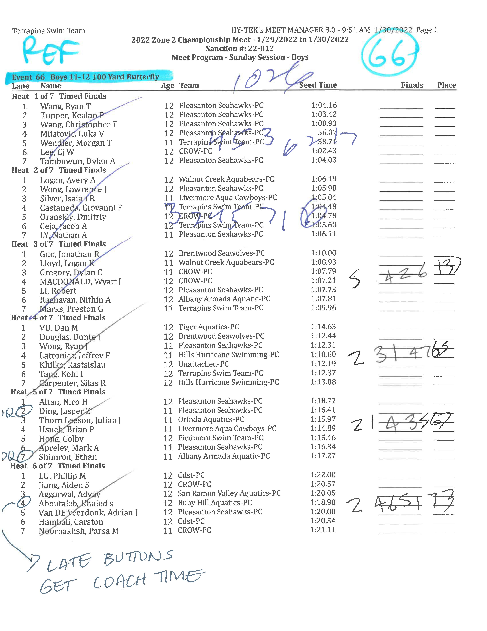
SAMPLE PRINTOUTS
Referee Sheet

Slide 29
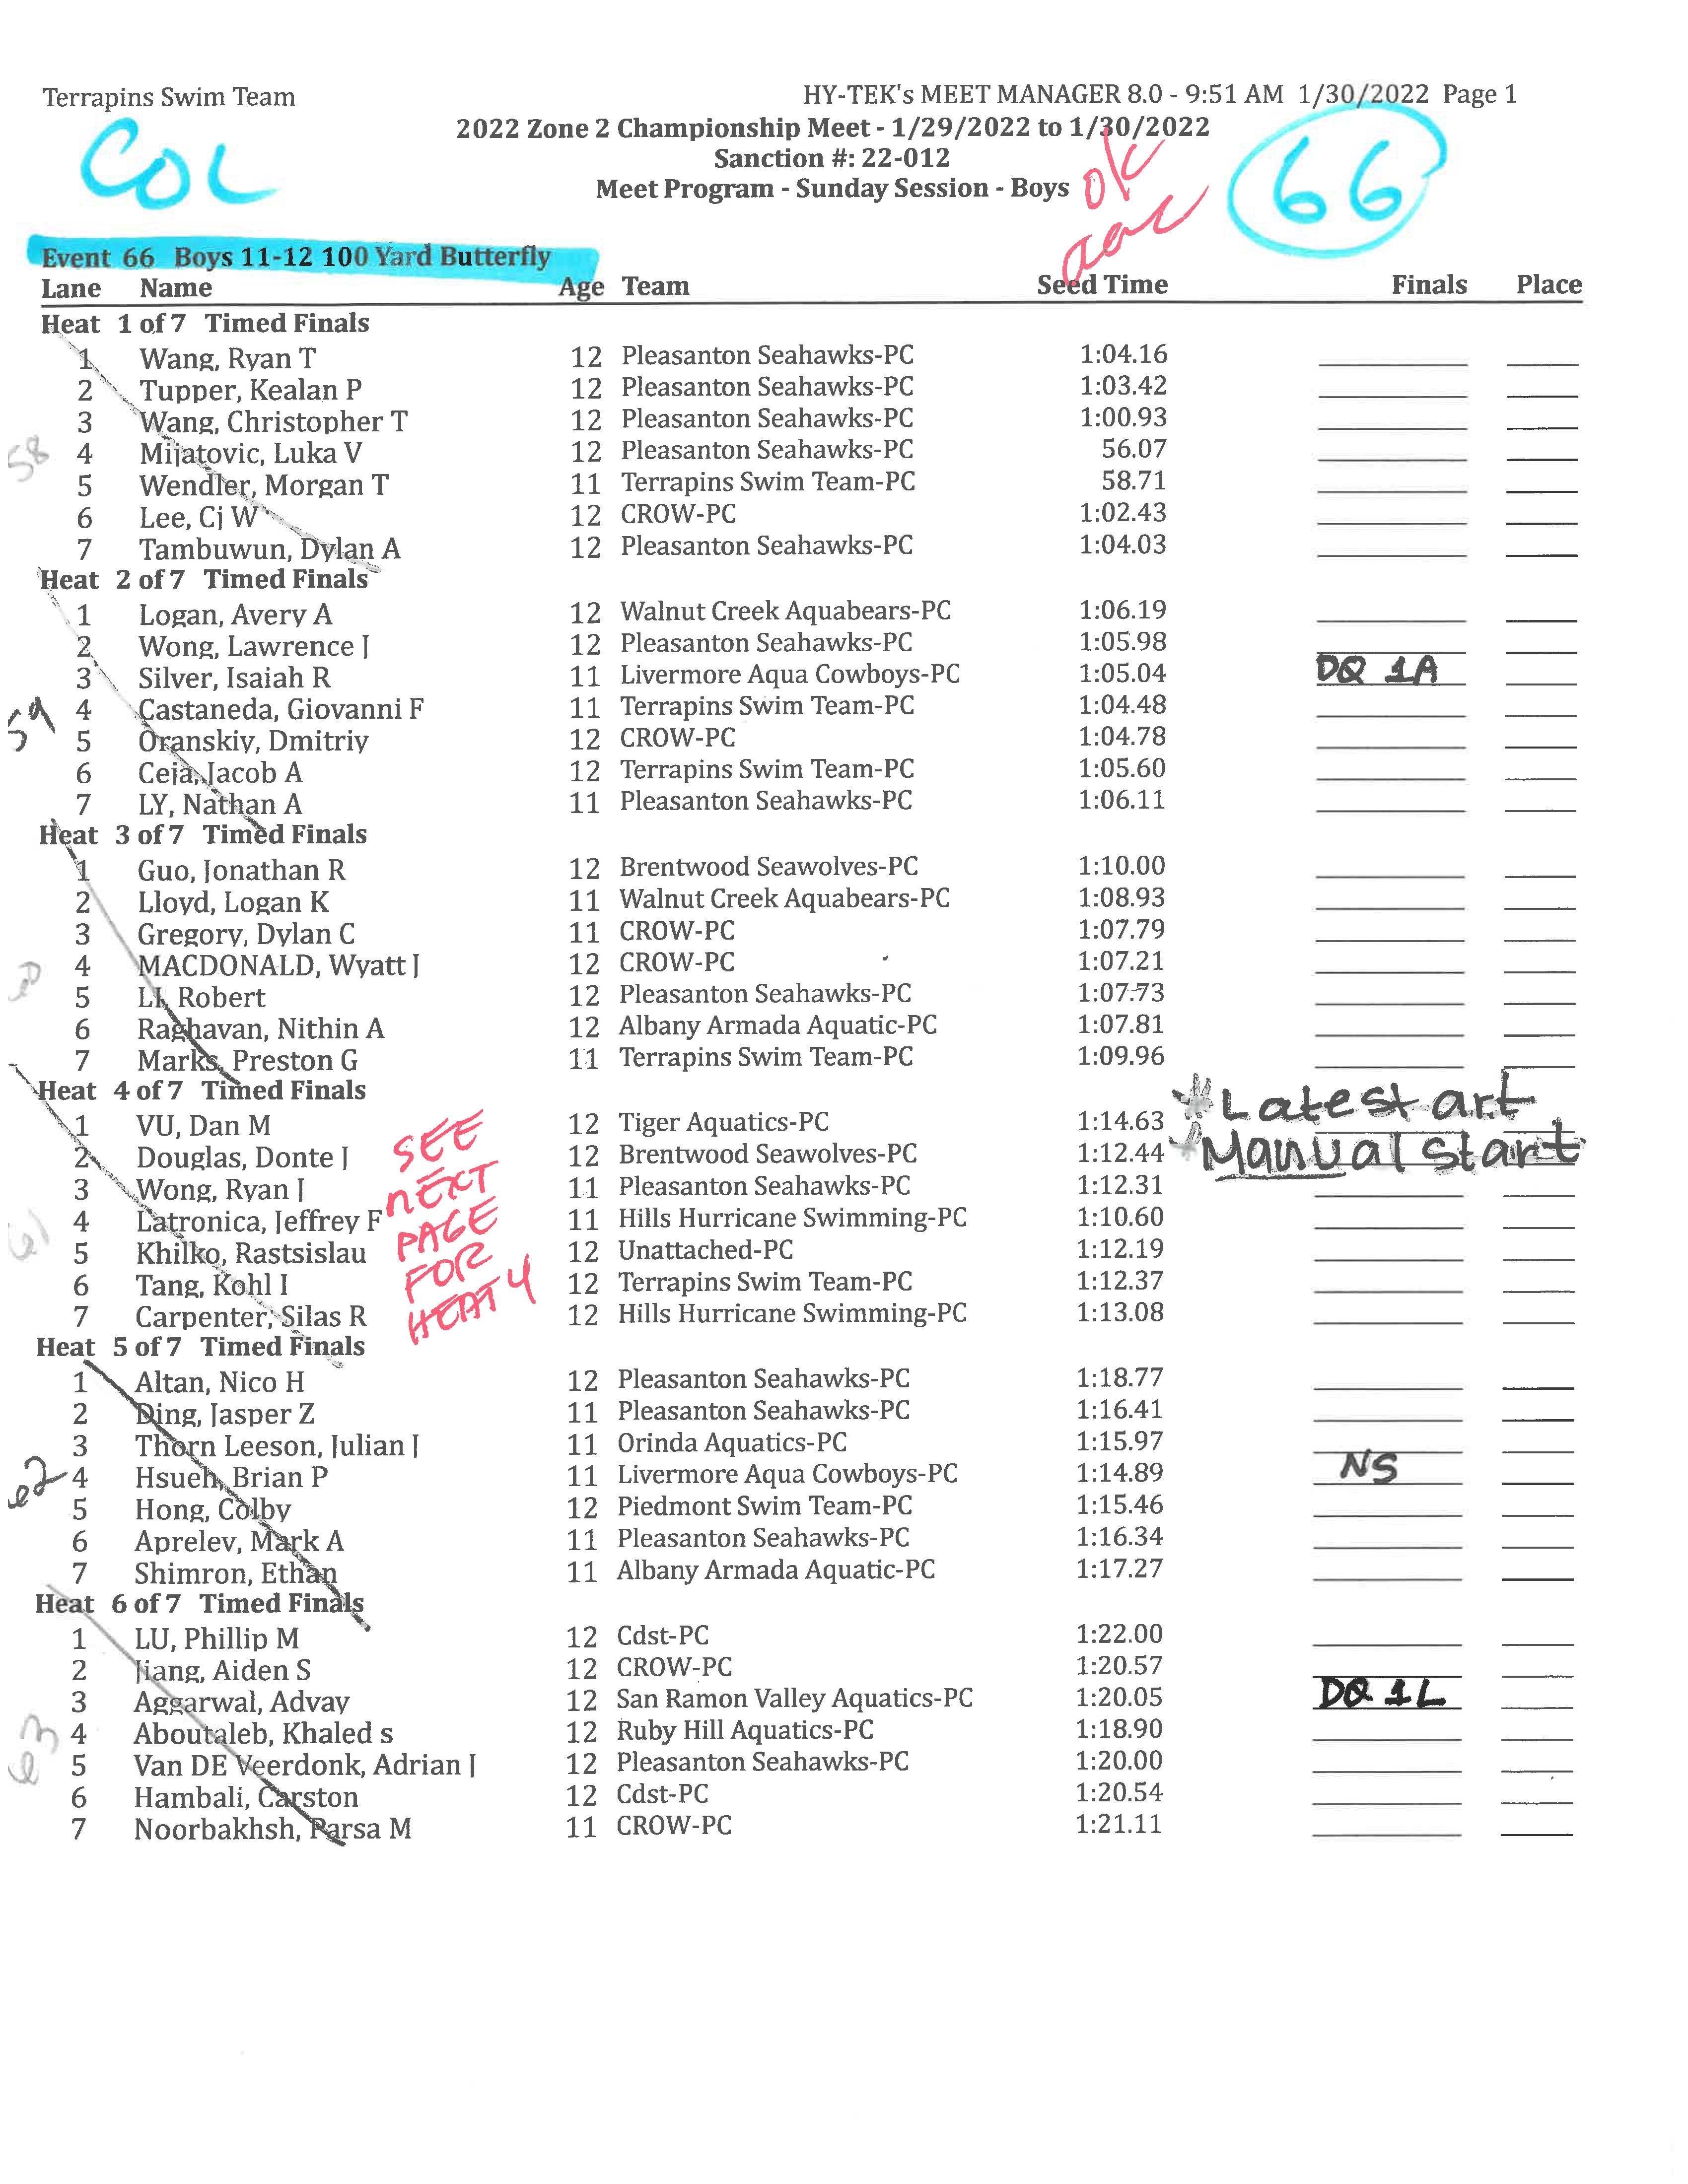
SAMPLE PRINTOUTS
Referee Sheet
Colorado Sheet

Slide 30
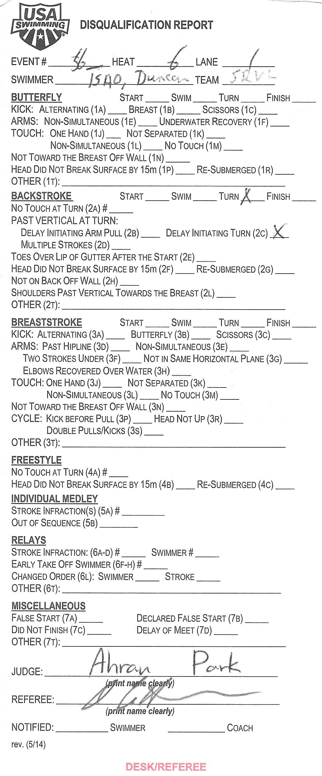
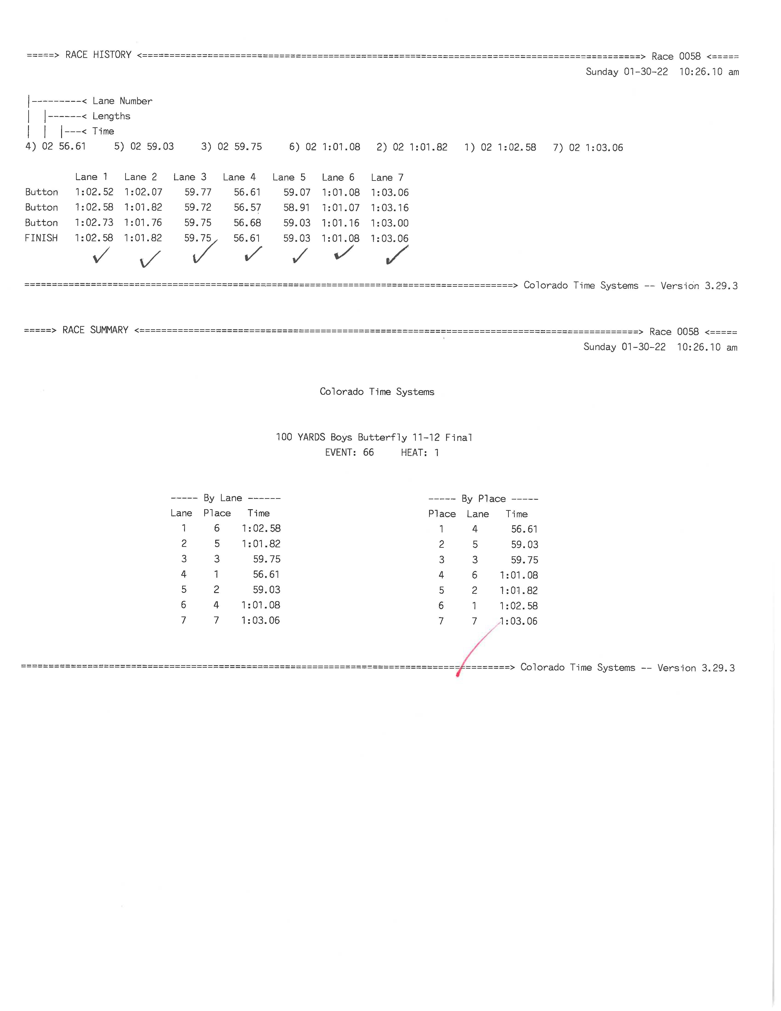
SAMPLE PRINTOUTS
Referee Sheet
Colorado Sheet
Colorado Heat Sheet (or race summary sheet)

Slide 31
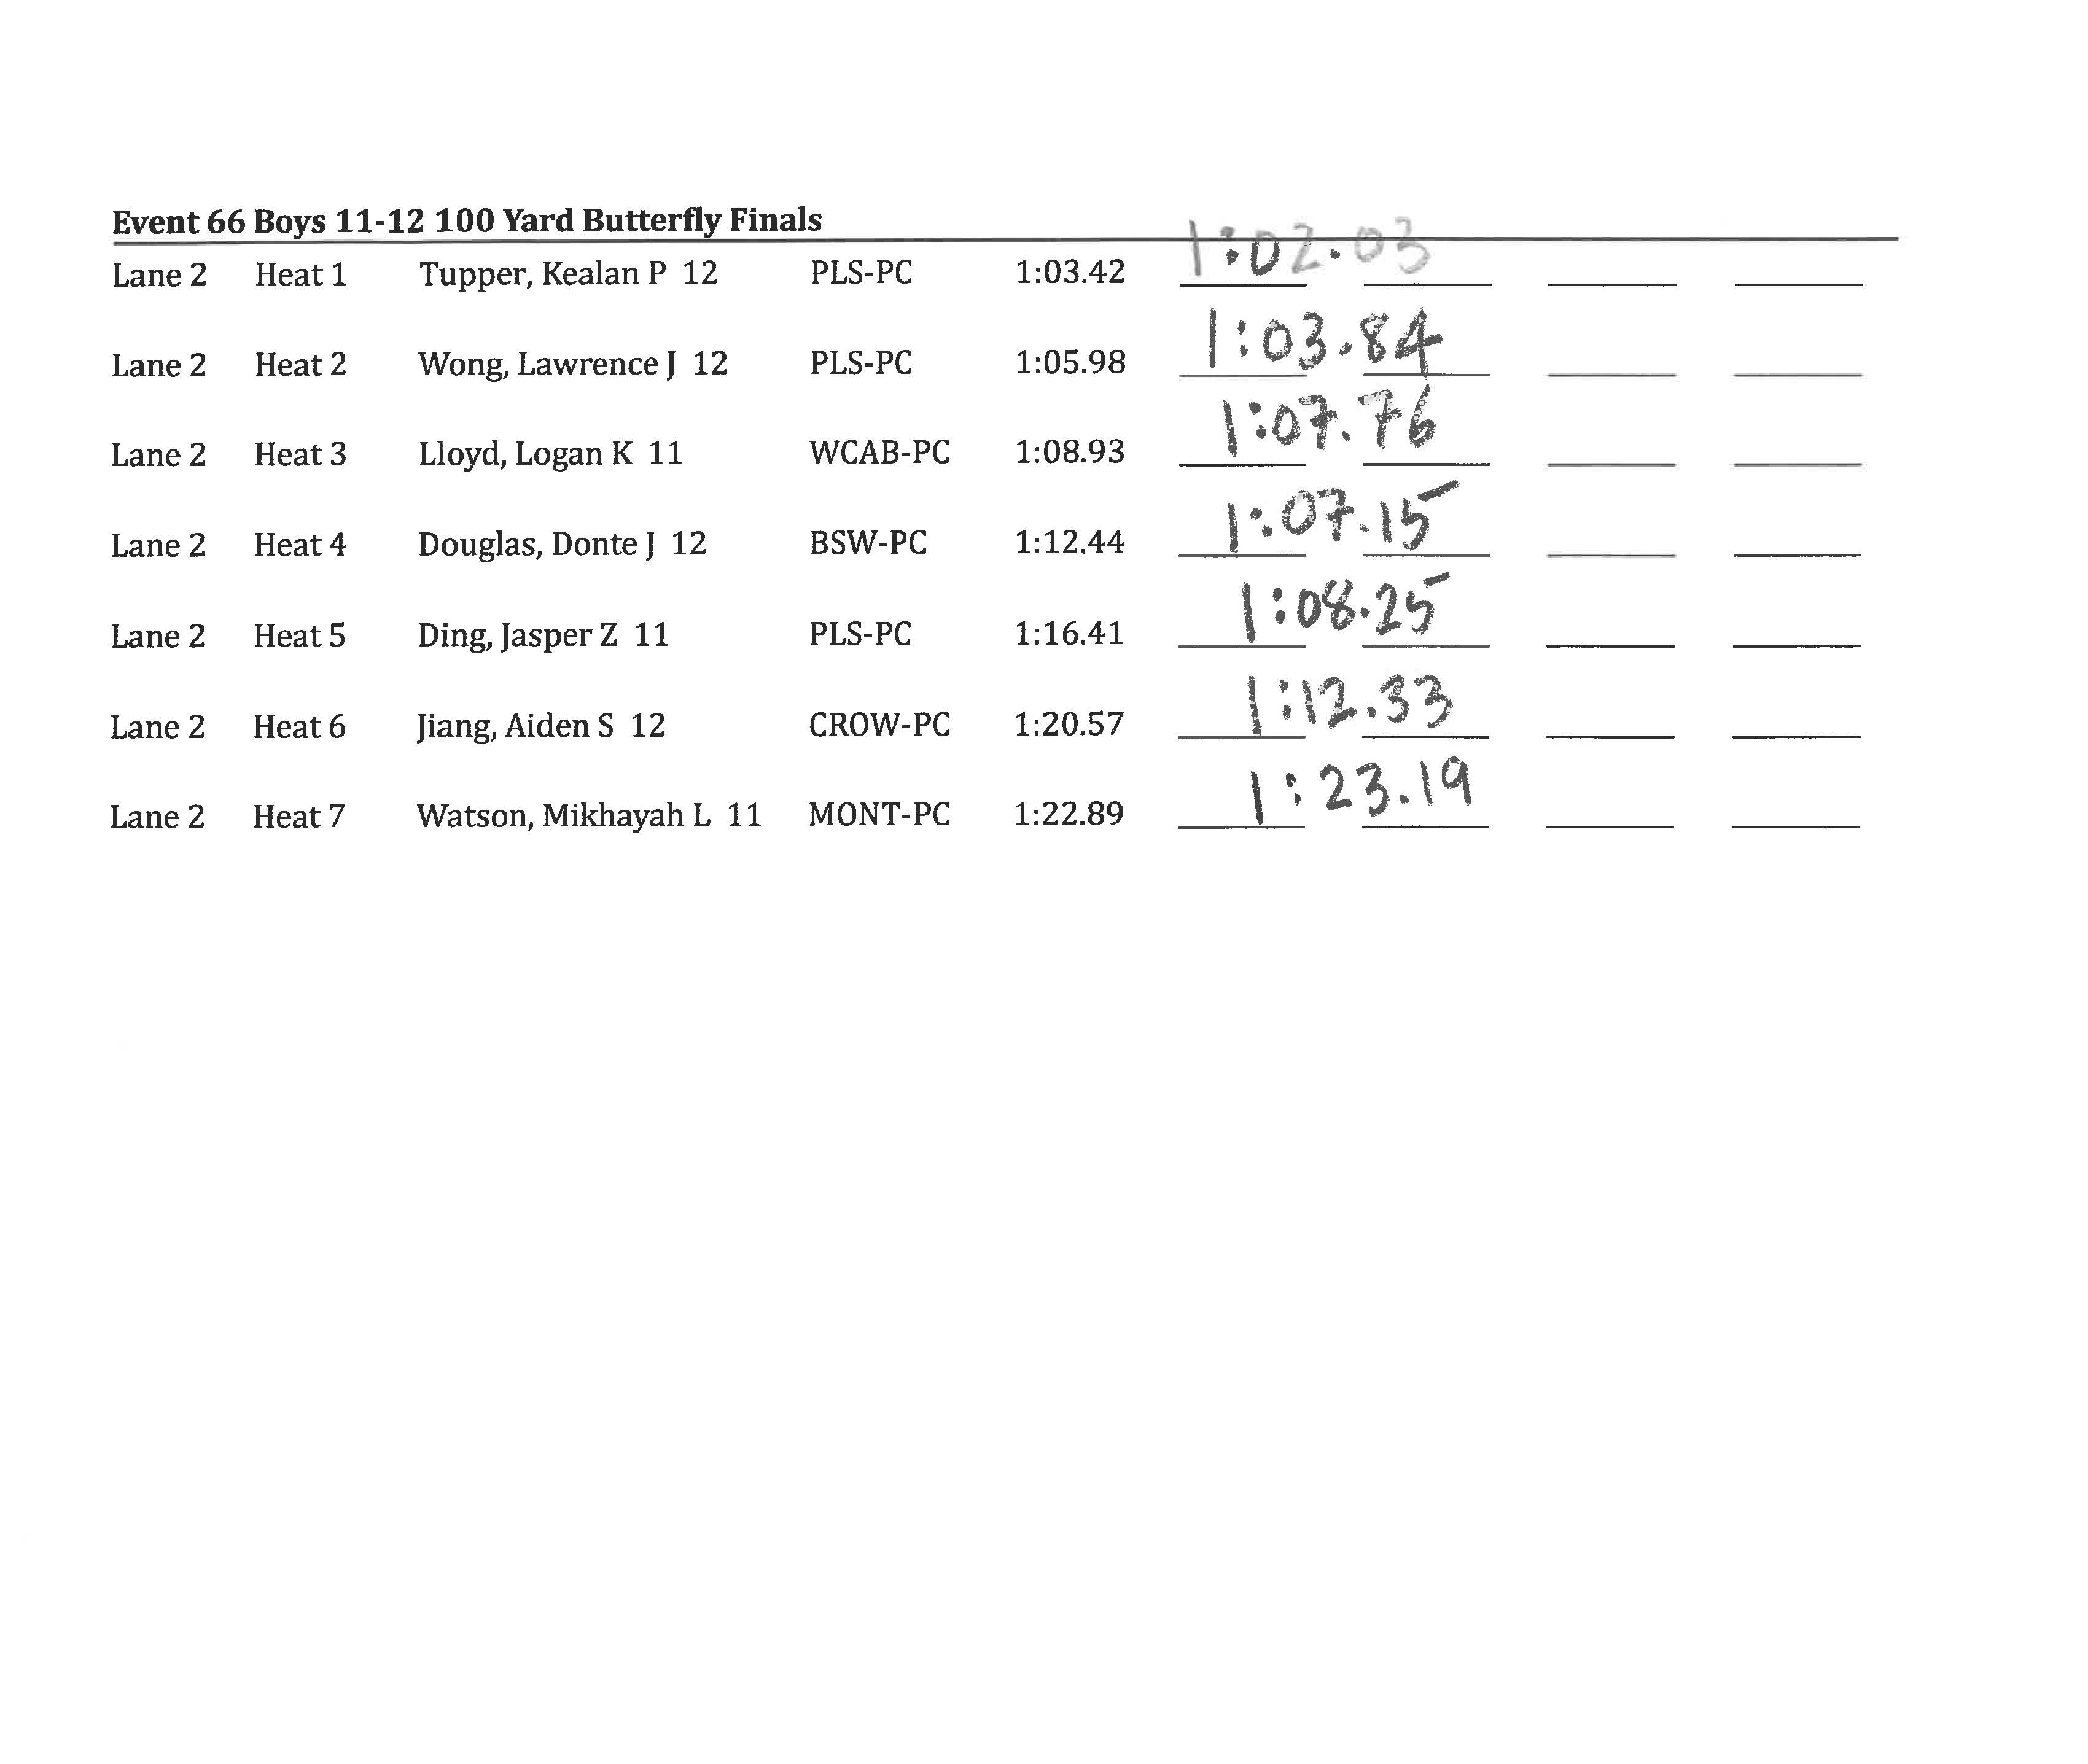
SAMPLE PRINTOUTS
Referee Sheet
Colorado Sheet
Colorado Heat Sheet (or race summary sheet)
Lane Timer Sheets

Slide 32
COLORADO SYSTEM 5
(no pads)

Slide 33
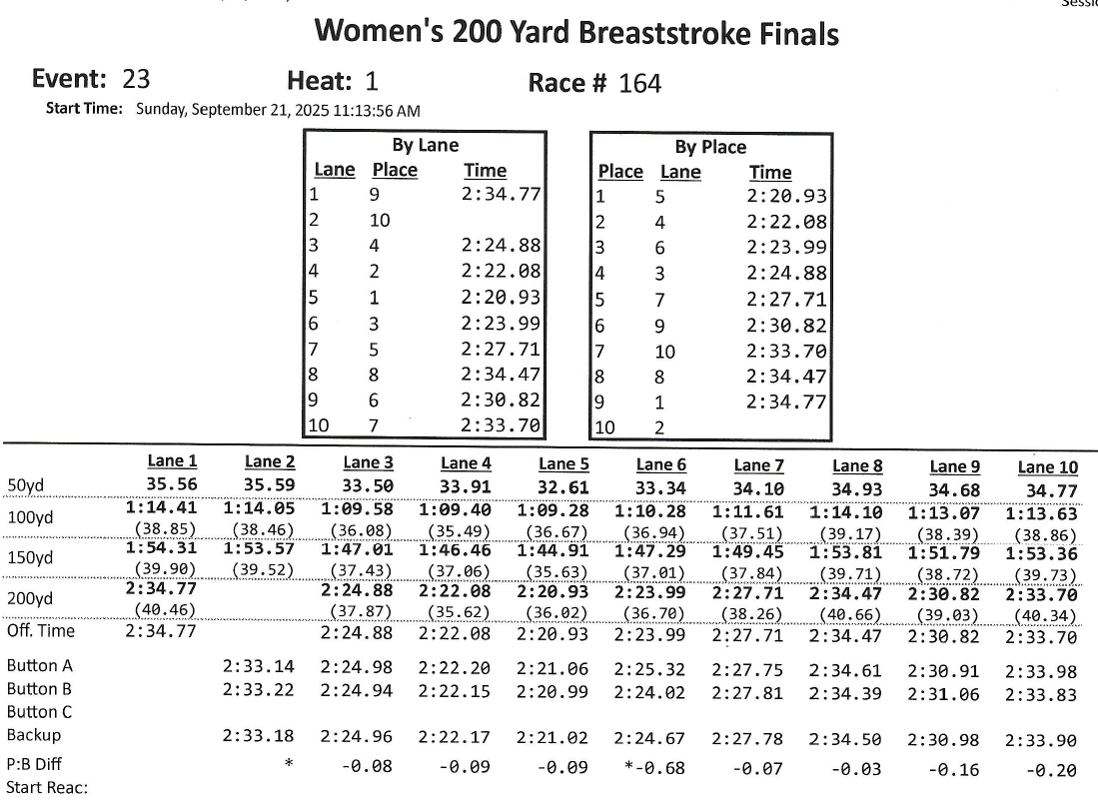
COLORADO SYSTEM 7
(with pads)

