Slide 1
ADMIN TRAINING
PART 1

Slide 2
What is the role of the Admin Official
This is the DRY side of the officiating TEAM.
We do the background and get papers together so the WET side can occur seamlessly.
Handle the check in process
Close and Seed the events
Verify and adjust times and review results

Slide 3
Our big goal…
To create a seamless, stress-free process for our swimmers so they can perform to the best of their ability.
We should not be adding stress to their swims.

Slide 4
What we plan to cover this morning:
Check in
Closing of events
Seeding events

Slide 5
Part 2 is this afternoon
Verifying times
Knowledge Check
Questions

Slide 6
What should I do to prepare
Familiarize yourself with the Meet Sheet
-What kind of meet (CBA, T&F)
-Maximum events per day
-Single or dual sided
-Deck Seeded vs Pre-seeded (specific seeding order)
-Start times/ timelines
-Penalties?
-Scoring/ Points/ Awards
Communicate with Meet Referee
-How many people do you have helping the Admin team?
-What experience do they have?- this may help you with breaking down tasks and where someone may be assigned.
Communicate with Meet Director
-Will they have volunteers for check in, closing events(with experience), runners to move paperwork around
Will host team have supplies for check in supplies like rulers, pencils, clear tape etc

Slide 7
Email from Laurie Benton
-Will have information from Pac Swim with Membership Reconciliation Report showing swimmers that may have name changes, DOB updates, TEAM changes and lack of registration, and missing APT
-Laurie Benton will provide you with link for athlete to allow swimmers to register
-Communicate with Meet Director if they will be sending emails to the coaches/ teams of those swimmers who need to update the USA swim reg or if you need to do it.
-Swimmers with out-of-date registration or APT will not be able to participate until completed (must show proof of completion)

Slide 8
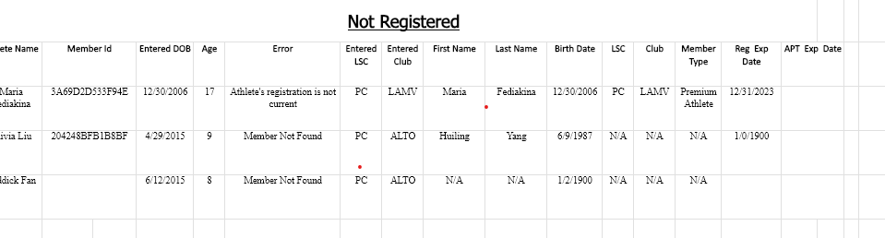

Slide 9
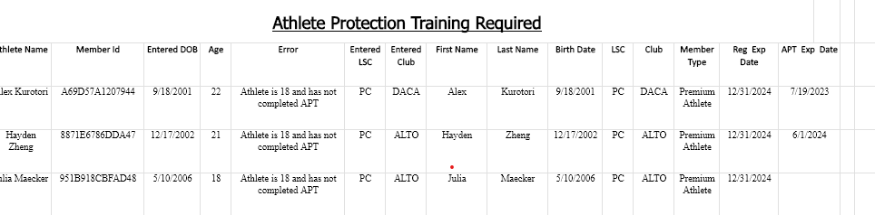


Slide 10
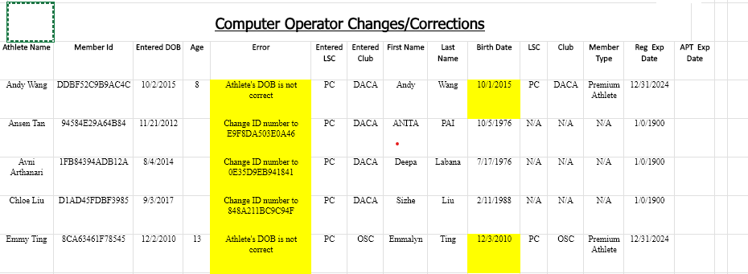


Slide 11
Link sent from Laurie for UN registration Coaches have their team link as well which is sent to the swimmer

Slide 12
Typical admin toolbox
Clipboards (for timers, DR, SR, check in etc). May coordinate with Meet Director for timer boards
Pens (red for closing)
Highlighters (various colors)
Pencils (check in/ timers)
Rulers (check in)
Clear Tape
Filing system
Binders (scratch)
Notebook or post it notes for quick notes
Stapler

Slide 13
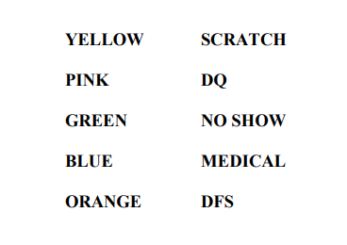

Highlighter colors…
Depends on your meets and the team you are working with where colors may / not be used.
If you are lead, you can make the decision
May need to highlight the swimmers that have too many events entered, registration issues, APT

Slide 14
Pre seeded meets
This tells us that the swimmers do not need to check in prior to the start of the meet.

Slide 15
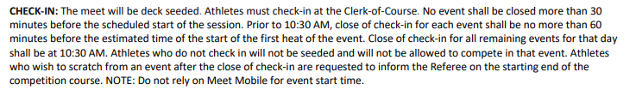
Deck seeded
This is from a meet sheet. It clearly outlines that there will be a check in table, it tells you when the first event will close and, in this case, all other events will close at 1030am.

Slide 16
On Deck --- check in
Lay out papers and tape them down
Educate the volunteers on how to work the check in table
Coordinate with Meet Director to find out what time the check in volunteers are attending. Then talk to them all at once.
Provide pencil to the athlete and place the ruler above the Athlete’s name
Athlete initials next to their name
Athlete circles events they want to swim.
If wanting to “scratch”, they place “X” over the event number, initial next to it and note the time of scratch.
IF COACH is checking in an athlete, same process but should have coach initial and write COACH next to name as well.

Slide 17
Check in reminder
Keep writing utensils in your hand or athlete. Avoid leaving them unattended on the table
Ensure accuracy. Clear circles and X help when “closing “ events

Slide 18
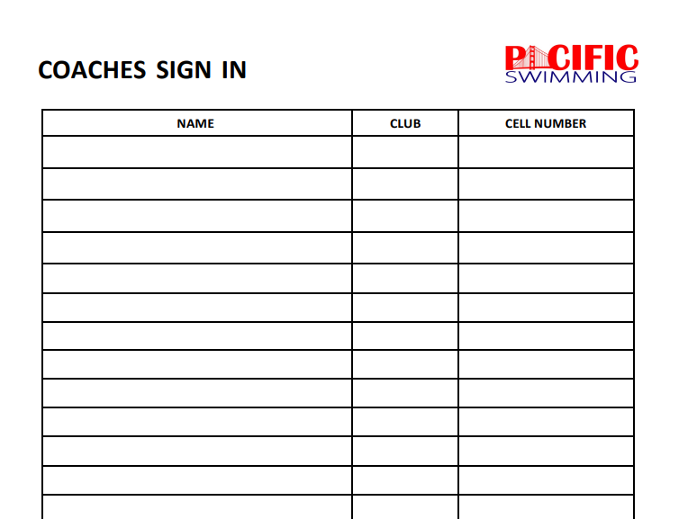
Coach Check in:

Slide 19
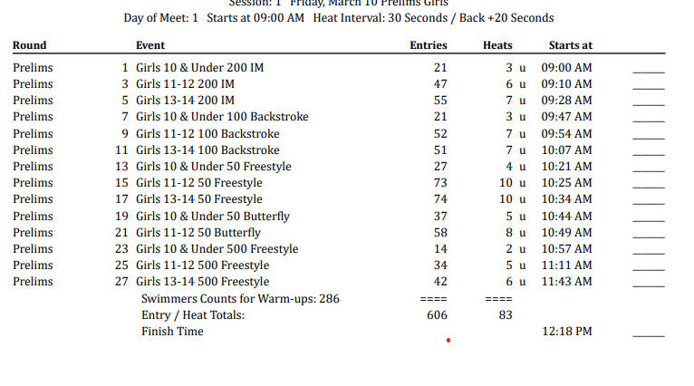
When do I close:

Slide 20
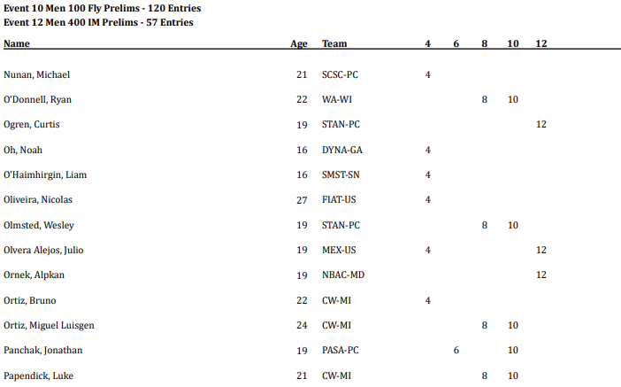
Check in sheet

Slide 21
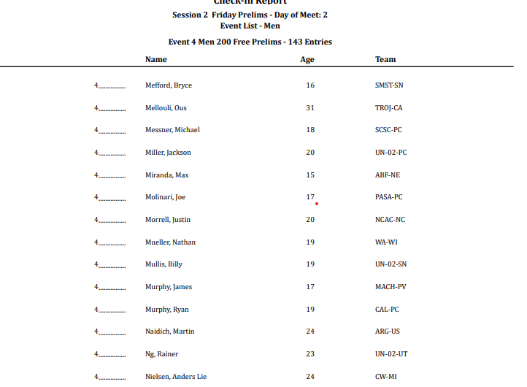
Scratch sheet

Slide 22
Closing events…
Work with computer operator to determine closing times per meet sheet.
Typically: no event closes more than 30 minutes before the scheduled start of the session. Events can close no sooner than 60 minutes before the estimated start of that event (first heat).
What does this mean? That means the computer operator will generate a timeline based on meet ref requests. Subract 60 minutes from that start time for each event and that is the closing time. However, we cannot close the first events more than 30 minutes before so there is some adjusting for the first few events.
Some meets may close all remaining at 10:30am so make sure to read meet sheet.
Distance events may have a specific closing time--- keep track of this.
If you are running a BOYS and GIRLS side, they will have independent running times and therefore independent timelines for closing as well.
Keep track of the closing times and if meet is running faster, you will need to make adjustments- this conversation can be with the computer operator to help out.

Slide 23
Close events– how to do it
One person will go down the line and highlight the swimmers that did not check into that event.
Once highlighted, the person will call out the names to the Scratch pad person who has the complete list of names for that event. The person will highlight those names that correspond to those that have not checked in.
Swap roles so the person on the check in list will now have the clipboard and that person will be looking at names on the table. Check the work.
Count number of highlighted names (clipboard and check in table)
Confirm the numbers match. Once it matches, draw a red line along the events and place clear tape over that event number. Write the # above that was scratched and time.
Give the sheet on the clipboard to the computer operator so the event can be seeded

Slide 24
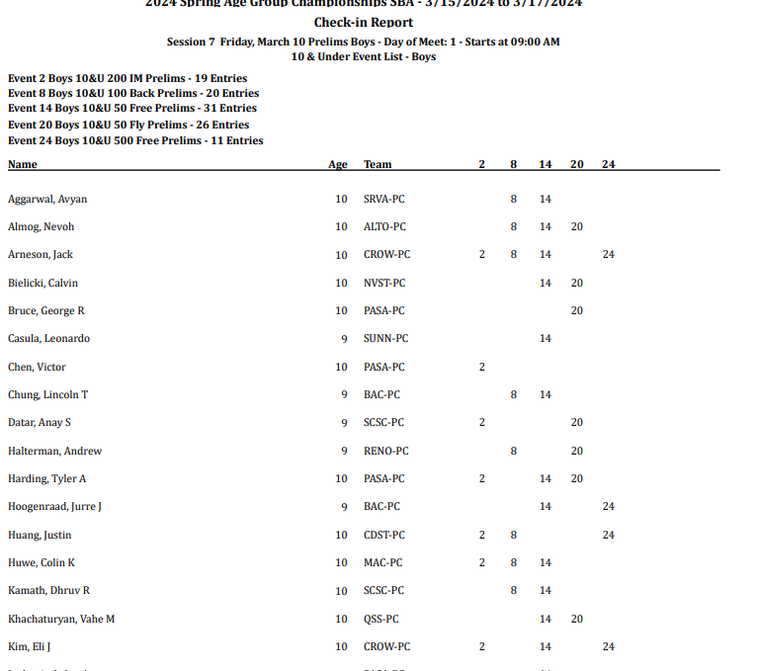






Slide 25




Slide 26
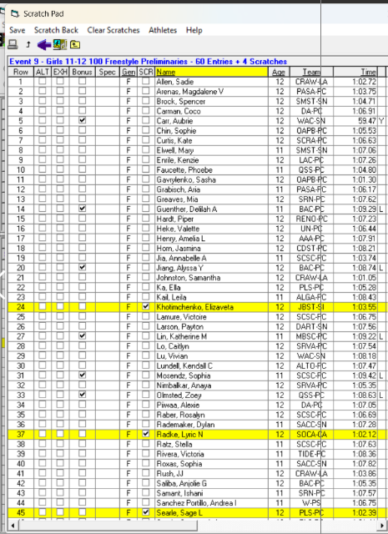
Another form of scratch paperwork

Slide 27
What’s next???
The computer operator will seed the event.
Let computer operator know how many copies of what you want
Once there is a single copy, review it and make sure it is done correctly
-Discuss with Meet Ref how many copies and what kind of papers you want to have for the corner.
-Deck Ref, Starter, Timing Operator, CJ, Admin
Single column, Double, triple?
Timing sheets
Heat and Lane sheets for posting

Slide 28
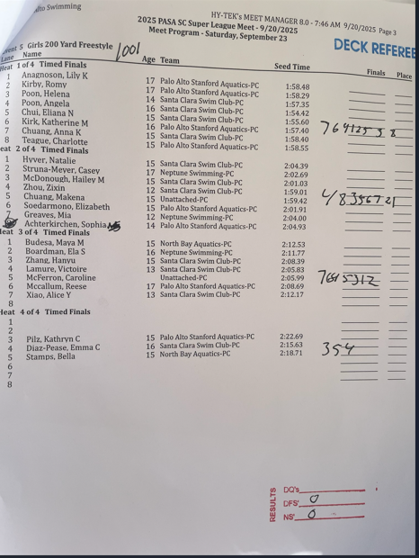
DR paper. Single column

Slide 29
Runners…
Someone from the Admin team will need to “teach” the runners what to do. Discuss where papers need be posted as well.
Papers may need to be stamped with the DR/SR/ADM/Timing/CJ/ Heat and Lane/ Timers
Papers need to be taken to the corner and distributed
Timer Sheets need to get to the timers. Heat and Lane papers need to be posted (location TBD)

Slide 30
Times are verified
This can be done in an office or out on deck. This would depend on the number of Admins on your team
Once the times are verified, papers go to the computer operator who will update and print out results.

Slide 31
RESULTS:
Print copies as needed. Work with Meet Director to determine where to post and what to do.
May need 2 copies (1 to post, 1 to keep )
Do you have to print one for awards? Get that to the awards team
The papers need to be filed by event number.

Slide 32
Filing… importance
Make sure the papers are filed by event.
Papers should be organized as well.
Final result, DQ slips stapled on top, Admin paper, DR, SR, Timing, timing system papers, timer sheet (in this order).
Keep all scratch sheets in order. Place them into event files
If data is lost, if there are time challenges from coaches etc, you need to be able to go back to your papers and provide clarification. If changes need to be made, then you can get that done. Challenges should be done 30 minutes after results are posted

Slide 33

Thank you

Slide 34
Thank you
We will see you this afternoon!!! Maybe???
For a fun quiz. No cheating. And hands on exercises.

